Slide 1
Data Mining & Warehousing
By
Prof. Dr. O.P.Vyas
DAAD Fellow (Germany), AOTS Fellow(Japan)
Indian Institute of Information Technology, Allahabad

Slide 2
D.M.W.
Data Mining
  Overview of Data Engineering
    RDBMS, Multi Dimensional Databases, OLAP, Data Warehouse
  DM: Overview of Techniques
    Algorithms & Implementations
  Data Mining tools & D2K: Software Engineering
  Association Rule Mining: Apriori Algorithm
  Classification & Predictive mechanism
  Clustering Analysis
  Issues in DM : User-Centric Vs Procedure centric
    Utility Mining issues
    Rare item Problem:Single MinSup problem
B.I. : Business Intelligence
  Business Intelligence
  Business Planning & Forecasting Technologies
  Computational Knowledge Discovery
  Association Rules Vs. Business Rules.
  Companies using Business Intelligence
    Master Card, Wall Mart, Burger King,
Social Network Analysis & Data Mining

Slide 3
Data Mining Functionalities
Data Mining
Association
Mining
Clustering
Analysis
Classification
A:R:M:
Techniques
Application
domain
Classification
Techniques
Asso.Classifiers

Slide 4
Data Mining
Data Mining
Association
Mining
Clustering
Classification
Techniques
Classification
Techniques
Associative Classification
(Combines the Association & Classification)
CBA, CMAR, CPAR & MCLP
Modifying the algorithms
Application
domain

Slide 5
DMW
DM Functionalities: ARM-Apriori Algorithm
  Learning: Supervised & Unsupervised
  Classification: Overview
    Working mechanism of Classifier
    Associative Classification
  Clustering Analysis
  Web Mining: Case Study of Google
    Searching Authoritative pages
    PageRank Algorithm

Slide 6
Classification
Classification
  Application of Classification task
    Business Intelligence, Bio Informatics
  Classification: Overview of Technique
    Model Construction & Model Usage
  Issues in Classification
  Classification through DTC
  Various Classifiers: Bayesian Classifiers, Bayesian Belief Network
  Ongoing research efforts in DM

Slide 7
Classification and Prediction
What is Classification?
Issues regarding classification and prediction
Classification by decision tree induction
Bayesian Classification
Rule-based classification
Classification by back propagation (ANN)
Support Vector Machines (SVM)
Associative Classification
Lazy learners (or learning from your neighbors)
Other Classification methods
  Rough Set Approach
  Fuzzy Set approach
  Genetic Algorithm
Ensemble methods
Prediction
Accuracy and error measures
Model selection
Summary
Data Mining: Concepts and Techniques

Slide 8
Issues: Evaluating Classification Methods
Accuracy
  classifier accuracy: predicting class label
  predictor accuracy: guessing value of predicted attributes
Speed
  time to construct the model (training time)
  time to use the model (classification/prediction time)
Robustness: handling noise and missing values
Scalability: efficiency in disk-resident databases
Interpretability
  understanding and insight provided by the model
Other measures, e.g., goodness of rules, such as decision tree size or compactness of classification rules
Data Mining: Concepts and Techniques

Slide 9
Data Classification — A Two-Step Process
Model construction: describing a set of predetermined classes
[ Learning ]
  Each tuple / sample is assumed to belong to a predefined class, as determined by the class label attribute.
  The set of tuples used for model construction: training set (given data).
  The model is represented as classification rules, decision trees, or mathematical formulae.
Model usage: for classifying future or unknown objects
[ Classification ]
  Estimate accuracy of the model
    The known label of test sample is compared with the classified result from the model
    Accuracy rate is the percentage of test set samples that are correctly classified by the model
    Test set is independent of training set, otherwise over-fitting will occur

Slide 10



Classification Process (1): Model Construction ( Learning)
Classification
Algorithms
Training
Data
Classifier
(Model)
Classification rules
IF rank = ‘professor’
OR years > 6
THEN tenured = ‘yes’

Slide 11




Classification Process (2): Use the Model in Prediction
( classification)
Classifier
Test
Data
Unseen Data
(Jeff, Professor, 4)
Tenured?

Slide 12
Classification and Prediction
What is classification? What is prediction?
Issues regarding classification and prediction
Classification by decision tree induction
Bayesian Classification
Rule-based classification
Classification by back propagation (ANN)
Support Vector Machines (SVM)
Associative Classification
Lazy learners (or learning from your neighbors)
Other Classification methods
  Rough Set Approach
  Fuzzy Set approach
  Genetic Algorithm
Ensemble methods
Prediction
Accuracy and error measures
Model selection
Summary
Data Mining: Concepts and Techniques

Slide 13

Decision Tree Classification Task
Decision Tree

Slide 14

Decision Tree Induction
A decision tree is a flow chart like tree structure, where each internal node denoted a test on an attribute, each branch represents an outcome of the test, and leaf nodes represent classes or class distribution.
categorical
categorical
continuous
class
Splitting Attributes
Refund
Yes
No
NO
MarSt
Single, Divorced
Married
TaxInc
NO
< 80K
> 80K
NO
YES
Training Data
Model: Decision Tree

Slide 15
Another Example of Decision Tree
categorical
categorical
continuous
class
MarSt
Single, Divorced
Married
NO
Refund
Yes
No
NO
TaxInc
< 80K
> 80K
NO
YES
There could be more than one tree that fits the same data!

Slide 16
DTC is powerful and perhaps most widely used modeling technique in Classification.
 Decision trees classify instances by sorting them down the tree from the root to some leaf node, which provides the classification of the instance

Slide 17
Definition
Decision tree is a classifier in the form of a tree structure
  Decision node: specifies a test on a single attribute
  Leaf node: indicates the value of the target attribute
  Arc/edge: split of one attribute
  Path: a disjunction of test to make the final decision
Decision trees classify instances or examples by starting at the root of the tree and moving through it until a leaf node.

Slide 18
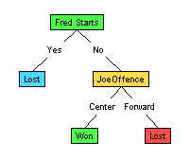
DTC: Illustration
(1) Which to start? (root)
(2) Which node to proceed?
(3) When to stop/ come to conclusion?

Slide 19
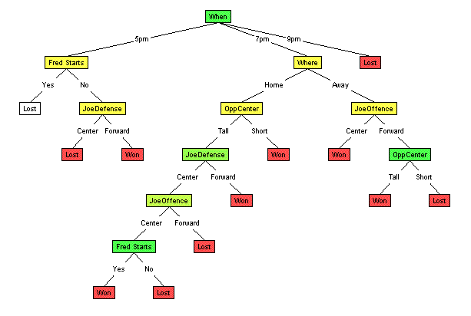
Random split
The tree can grow huge
These trees are hard to understand.
Larger trees are typically less accurate than smaller trees.

Slide 20
Principled Criterion
Selection of an attribute to test at each node - choosing the most useful attribute for classifying examples.
information gain
  measures how well a given attribute separates the training examples according to their target classification
  This measure is used to select among the candidate attributes at each step while growing the tree

Slide 21
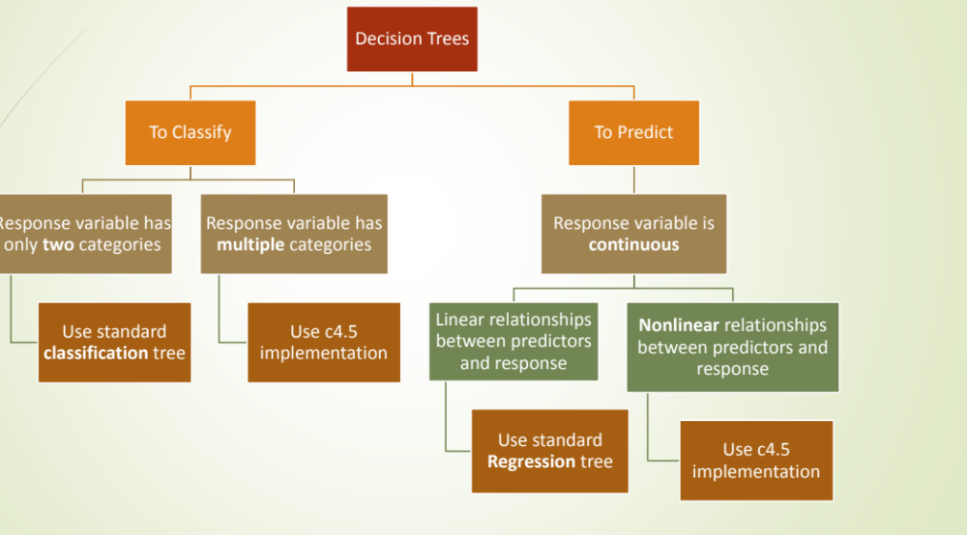
DTC

Slide 22
Algorithm for Decision Tree Induction
Basic algorithm (a greedy algorithm)
  Tree is constructed in a top-down recursive divide-and-conquer manner
  At start, all the training examples are at the root
  Attributes are categorical (if continuous-valued, they are discretized in advance)
  Examples are partitioned recursively based on selected attributes
  Test attributes are selected on the basis of a heuristic or statistical measure (e.g., information gain)
Conditions for stopping partitioning
  All samples for a given node belong to the same class
  There are no remaining attributes for further partitioning – majority voting is employed for classifying the leaf
  There are no samples left

Slide 23
DTC
The algorithms that are used for constructing decision trees work by choosing a variable at each step that is the next best variable to use in splitting the set of items.
"Best" is defined by how well the variable splits the set into subsets that have the same value of the target variable. Different algorithms use different formulae for measuring "best".
The recursion is completed when the when splitting no longer adds value to the predictions or when subset at a node all has the same value of the target variable.
In data mining, trees can be described also as the combination of mathematical and computational techniques to aid the description, categorisation and generalisation of a given set of data.

Slide 24
DTC
During the late 1970s and 1980s J. Ross Quinlan developed a decision tree algorithm known as ID3 ( Iterative Dichotomiser).
Quinlan later improved the ID3 algorithm to give C4.5 which became a benchmark to which newer supervised learning algorithms are often compared.
In 1984 CART ( Classification and Regression Trees) was developed using similar approach.
ID3,C4.5,CART are greedy Algorithms for the induction of decision trees.
Each algorithm uses an attribute selection measure to select the attribute tested for each non Leaf node in the tree.
These approaches Select the attribute with the highest information gain.
.

Slide 25
C4.5 & C5.0
C4.5 made a number of improvements to ID3. Some of these are:
  Handling both continuous and discrete attributes.
  Handling training data with missing attribute values.
  Handling attributes with differing costs.
  Pruning trees after creation - C4.5 goes back through the tree once it's been created and attempts to remove branches that do not help.
Improvements in C5.0/See5 algorithm
Quinlan went on to create C5.0. Some of these are:
  Speed - C5.0 is significantly faster than C4.5 (several orders of magnitude).
  Memory usage - C5.0 is more memory efficient than C4.5.
  Smaller decision trees - C5.0 gets similar results to C4.5 with considerably smaller decision trees.
  Support for boosting - Boosting improves the trees and gives them more accuracy.
Boosting is a machine learning meta-algorithm for performing supervised learning.

Slide 26
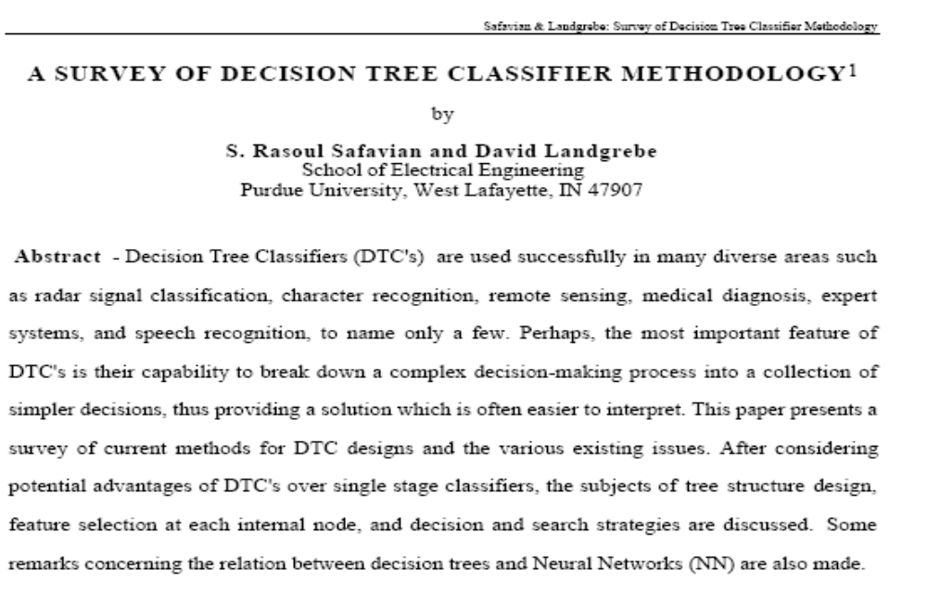
Decision Tree Classifiers : Survey paper

Slide 27
Classification in Large Databases
Classification—a classical problem extensively studied by statisticians and machine learning researchers
Scalability: Classifying data sets with millions of examples and hundreds of attributes with reasonable speed
Why decision tree induction in data mining?
  relatively faster learning speed (than other classification methods)
  convertible to simple and easy to understand classification rules
  can use SQL queries for accessing databases
  comparable classification accuracy with other methods
Data Mining: Concepts and Techniques

Slide 28
Constructing Classifier for B.I.
The leading Credit Card Company Visa International and Computer Company Acer Inc. has agreed to market the newly launched Laptop Computer.
For targeted marketing campaign, both the companies would like to use the existing database of Visa Credit card holders, to find out most likely buyers of their Computer.
For a given Database, your job will be to construct a Classifier.
This Classifier should take an input as the customer-details like
  Age,
  Income
  Student or Professional
  Credit_Card Ratings
And based on above inputs, the Classifier would Predict, whether the person is likely buyer of the Laptop Computer or not.

Slide 29
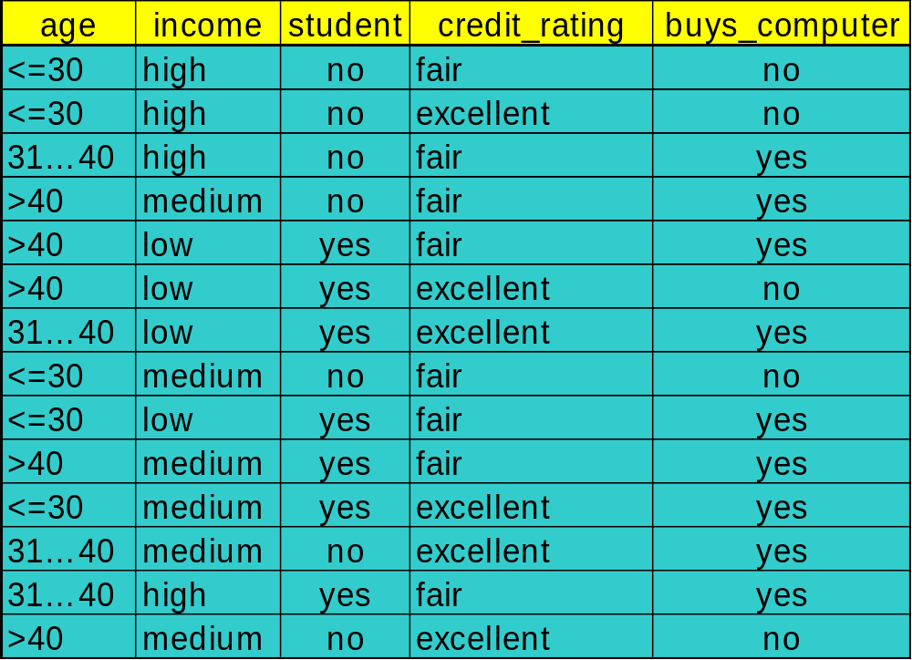
To construct Classifier from a given training data

Slide 30
Constructing Classifier
Data Domain Analysis
  Small Dataset with 04 discrete valued attributes.
  The Class label attributes are Boolean in nature!
    Class Labels:
      C1:buys_computer = ‘yes’
      C2:buys_computer = ‘no’
Predictive mechanism needed !
Business application with transactional database: no missing values !
Implementation details
  Execution of Java program with dataset.
  Constructing IF…. THEN… ELSE Rules.

Slide 31
DT induction: Issues
There are 04 attributes in the table, which attribute to start with at Root ?
  Attribute Selection measure or measure of goodness of split
    Select the attribute with the highest information gain
    Calculate information gain of each of 04 attributes by calculating;
      Expected information (entropy)
      Information needed
      Information Gained= (a)-(b)
    Find out the maximum I.G. out of attributes age, income, student, credit_rating

Slide 32




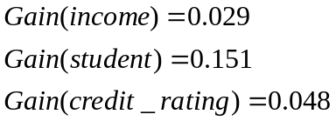
Attribute Selection: Information Gain
Class P: buys_computer = “yes”
Class N: buys_computer = “no”
means “age <=30” has 5 out of 14 samples, with 2 yes’es and 3 no’s. Hence
Similarly, Looking at other Gains, we can see the Gain(age) is max.
Data Mining: Concepts and Techniques

Slide 33

Gain Ratio for Attribute Selection (C4.5)
Information gain measure is biased towards attributes with a large number of values
C4.5 (a successor of ID3) uses gain ratio to overcome the problem (normalization to information gain)
  GainRatio(A) = Gain(A)/SplitInfo(A)
Ex.
  gain_ratio(income) = 0.029/0.926 = 0.031
The attribute with the maximum gain ratio is selected as the splitting attribute

Slide 34
Output: A Decision Tree for
“Buys_Computer”
age?
<=30
overcast
>40
31..40
Income | Student | Credit_rating | Class
High | No | Fair | no
High | No | excellent | no
medium | No | Fair | no
Income | Student | Credit_rating | Class
medium | No | Fair | yes
Income | Student | Credit_rating | Class
High | No | Fair | yes
Data Mining: Concepts and Techniques

Slide 35
Output: A Decision Tree for “buys_computer”
age?
<=30
overcast
>40
31..40
student?
yes
credit rating?
no
yes
excellent
fair
no
yes
no
yes
Data Mining: Concepts and Techniques

Slide 36
Constructing Classifier for B.I.
The leading Credit Card Company Visa International and Computer Company Acer Inc. has agreed to market the newly launched Laptop Computer.
For targeted marketing campaign, both the companies would like to use the existing database of Visa Credit card holders, to find out most likely buyers of their Computer.
For a given Database, your job will be to construct a Classifier.
This Classifier should take an input as the customer-details like
  Age,
  Income
  Student or Professional
  Credit_Card Ratings
And based on above inputs, the Classifier would Predict, whether the person is likely buyer of the Laptop Computer or not.
DTC was proposed as one of the alternative, but it showed some limitations.

Slide 37
Credit Card Database & BI application
As the Visa International has accumulated huge record of its Credit card holders for last 05 years amounting to terabytes of data.
Though larger the data better the training of the Classifiers ( some popularly used DTC algorithms C4.5 uses as much as 2/3 of the data for training the Classifiers).
In Case of our BI application, the problem starts with calculating Information Gain
    Every attributes involves all transactions for IG
    disk resident training data is not fitting into our memory for training activity.
    Scalability Problem!

Slide 38
Data Mining Software
Many providers of data mining software
  SAS Enterprise Miner, SPSS Clementine, Statistica Data Miner, MS SQL Server, Polyanalyst, KnowledgeSTUDIO, …
  See http://www.kdnuggets.com/software/suites.html for a list
  Good algorithms important, but also need good facilities for handling data and meta-data
We’ll use:
  WEKA (Waikato Environment for Knowledge Analysis)
    Free (GPLed) Java package with GUI
    Online at www.cs.waikato.ac.nz/ml/weka
    Witten and Frank, 2000. Data Mining: Practical Machine Learning Tools and Techniques with Java Implementations.
  R packages
    E.g. rpart, class, tree, nnet, cclust, deal, GeneSOM, knnTree, mlbench, randomForest, subselect

Slide 39
References
( Data Mining Concepts) J. Han, M.Kamber, Morgan Kaufmann Publications
(Association Rules) R. Agrawal, T. Imielinski, and A. Swami. Mining association rules between sets of items in large databases. SIGMOD'93.
(Max-pattern) R. J. Bayardo. Efficiently mining long patterns from databases. SIGMOD'98.
(Closed-pattern) N. Pasquier, Y. Bastide, R. Taouil, and L. Lakhal. Discovering frequent closed itemsets for association rules. ICDT'99.
(Sequential pattern) R. Agrawal and R. Srikant. Mining sequential patterns. ICDE'95
( FP Growth ) J. Han , J. Pei 2000.
DBMiner tutorials.

